Slide 1


Health & Stress
shape it up
Miss Aisha Bano
aisha.bano@nu.edu.pk

Slide 2
Objectives
Become more knowledgeable about stress.
Understand the process and effects of stress.
Identify your major sources of stress – situations, people, etc.
Anticipate stressful periods and plan for them
Develop successful stress management techniques and practice them

Slide 3
Stress Coping – Modern Perspective
Stress is inevitable
Stress has a cause, the cause can be known
We can prevent , control and cope up with stress

Slide 4
Ways to cope up with Stress
Knowledge
Skills
Objectives
Practise
Social Support

Slide 5
Sources of Stress
Environmental stressors 01
03 Socio-cultural stressors
Heat
Noise
pollution
Cold
Traffic
Financial problem
Relationship problems
work
Physiological stressors 02
04 Cognitive Factors
Illness
lack of sleep
Poor nutrition
Attitude
Belief
Our own thoughts

Slide 6
Stressful Life events
Severe
Trauma
Life Event
Short- Time
Long- Time
Daily hassles
Role Strain
Minor

Slide 7
Everyday Hassles
They can make you feel sick, and unable to sleep or concentrate properly.
These can accumulate and create an overall feeling of stress that we can’t blame on one thing.
.

Slide 8
Stress Responses
Behavioral
Cognitive
Biochemical
Emotional
Physiological

Slide 9
Stress Responses
Behavioral
Sleep disturbance
Use of alcohol/drugs
Absenteeism Aggression
Biochemical
Physiological
Increased metabolic rate
Altered hormone levels
(adrenaline, cortisol, ACTH)
Altered endorphin levels
Higher blood pressure
Rapid shallow breathing
Increased heart rate
Dilation of pupils
Muscle tension Dry mouth
Emotional
Cognitive
Depression/anxiety
Irritability
Crying , Suicide Loss of humour
Lack of concentration
Negative thoughts
Worrying Poor Memory

Slide 10
Negative Effects of Stress
Generate unpleasant emotion
Promoting negative thinking
Narrowing attention
Preoccupation
It consumes mental energy
Interpersonal problem
Lack of motivation
Reduce performance

Slide 11

Positive Effects of Stress
Prepare the body to meet challenges
Stress is a source of energy
Physiological arousal and alertness
Increase performance

Slide 12






Reactions to STRESS
OUTER WORLD
INNER WORLD 1
INNER WORLD 2
Physical
Attention
Physiological
Feelings
Thinking
Memory
External
Internal State
Cognitive
Environment
Person
P
E

Slide 13



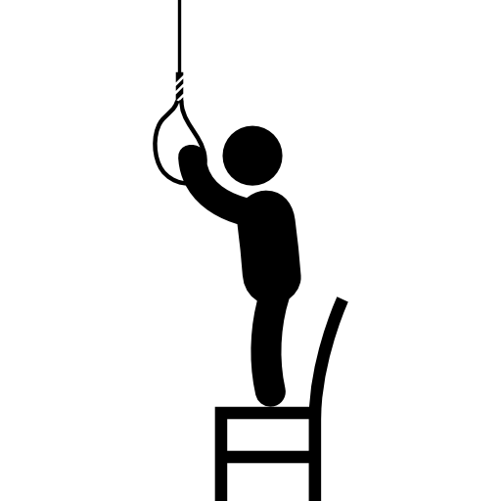

Reactions to STRESS
Isolation
Negative thinking
Unhappiness
Suicide Feelings
Worry
Fear
Angry

Slide 14
After a Stressful event
It is normal to feel some stress, anxiety, sadness or to be afraid it can take time for you to adjust to a lifestyle you are comfortable with again.

Slide 15
Reaction or Respond
Acting
Feeling
Thinking
Thinking
Feeling
Acting
We think erroneously - lack of thinking skills We feel out of control - poor emotional regulation
We act impulsively - poor self-regulated behaviour

Slide 16
Determining Factors
Predictability
Control
Frequency
Support

Slide 17
Why Life is Complex ?
Different point of view
Many people involved
Different solution
Problem is complex

Slide 18

What can I do?
It is important that you deal with feelings and reaction
you are having so that they don’t become overwhelming

Slide 19


Positive & Negative Coping Styles
Problem Solving
Utilizing Social Support
Looking for the Silver Lining
Avoidance
Self blame
Wishful thinking

Slide 20


Behavioral Stress Management ?
Progressive relaxation
Yoga
Meditation
Pray
Biofeedback

Slide 21
Trust in time
Personal
Coping
Strategies ?
Don't isolate yourself
Think positively
Keep a sense of humour
Think about yourself as relaxed
Exercise and get a pet

Slide 22

Habits
No drug or alcohol use
Eating breakfast
Maintaining normal weight
Getting adequate sleep
Regular exercise
Eating Regular meals

Slide 23
3’C
Control
Commitment
Challenge
Self-control, commitment and taking your problem as a challenge make you hardy and product you from stress .

Slide 24
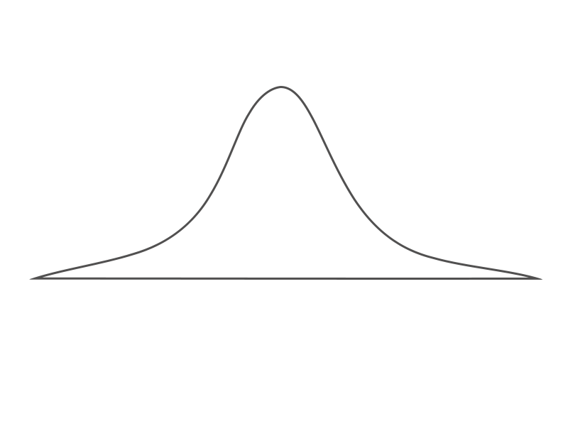

Typical relationship between
Performance & Stress
High
Level of Performance
Too Little Stress
Active
Excessive Stress
Confused
Relax
passive
Bored
Withdrawal
Low
Stress

Slide 25
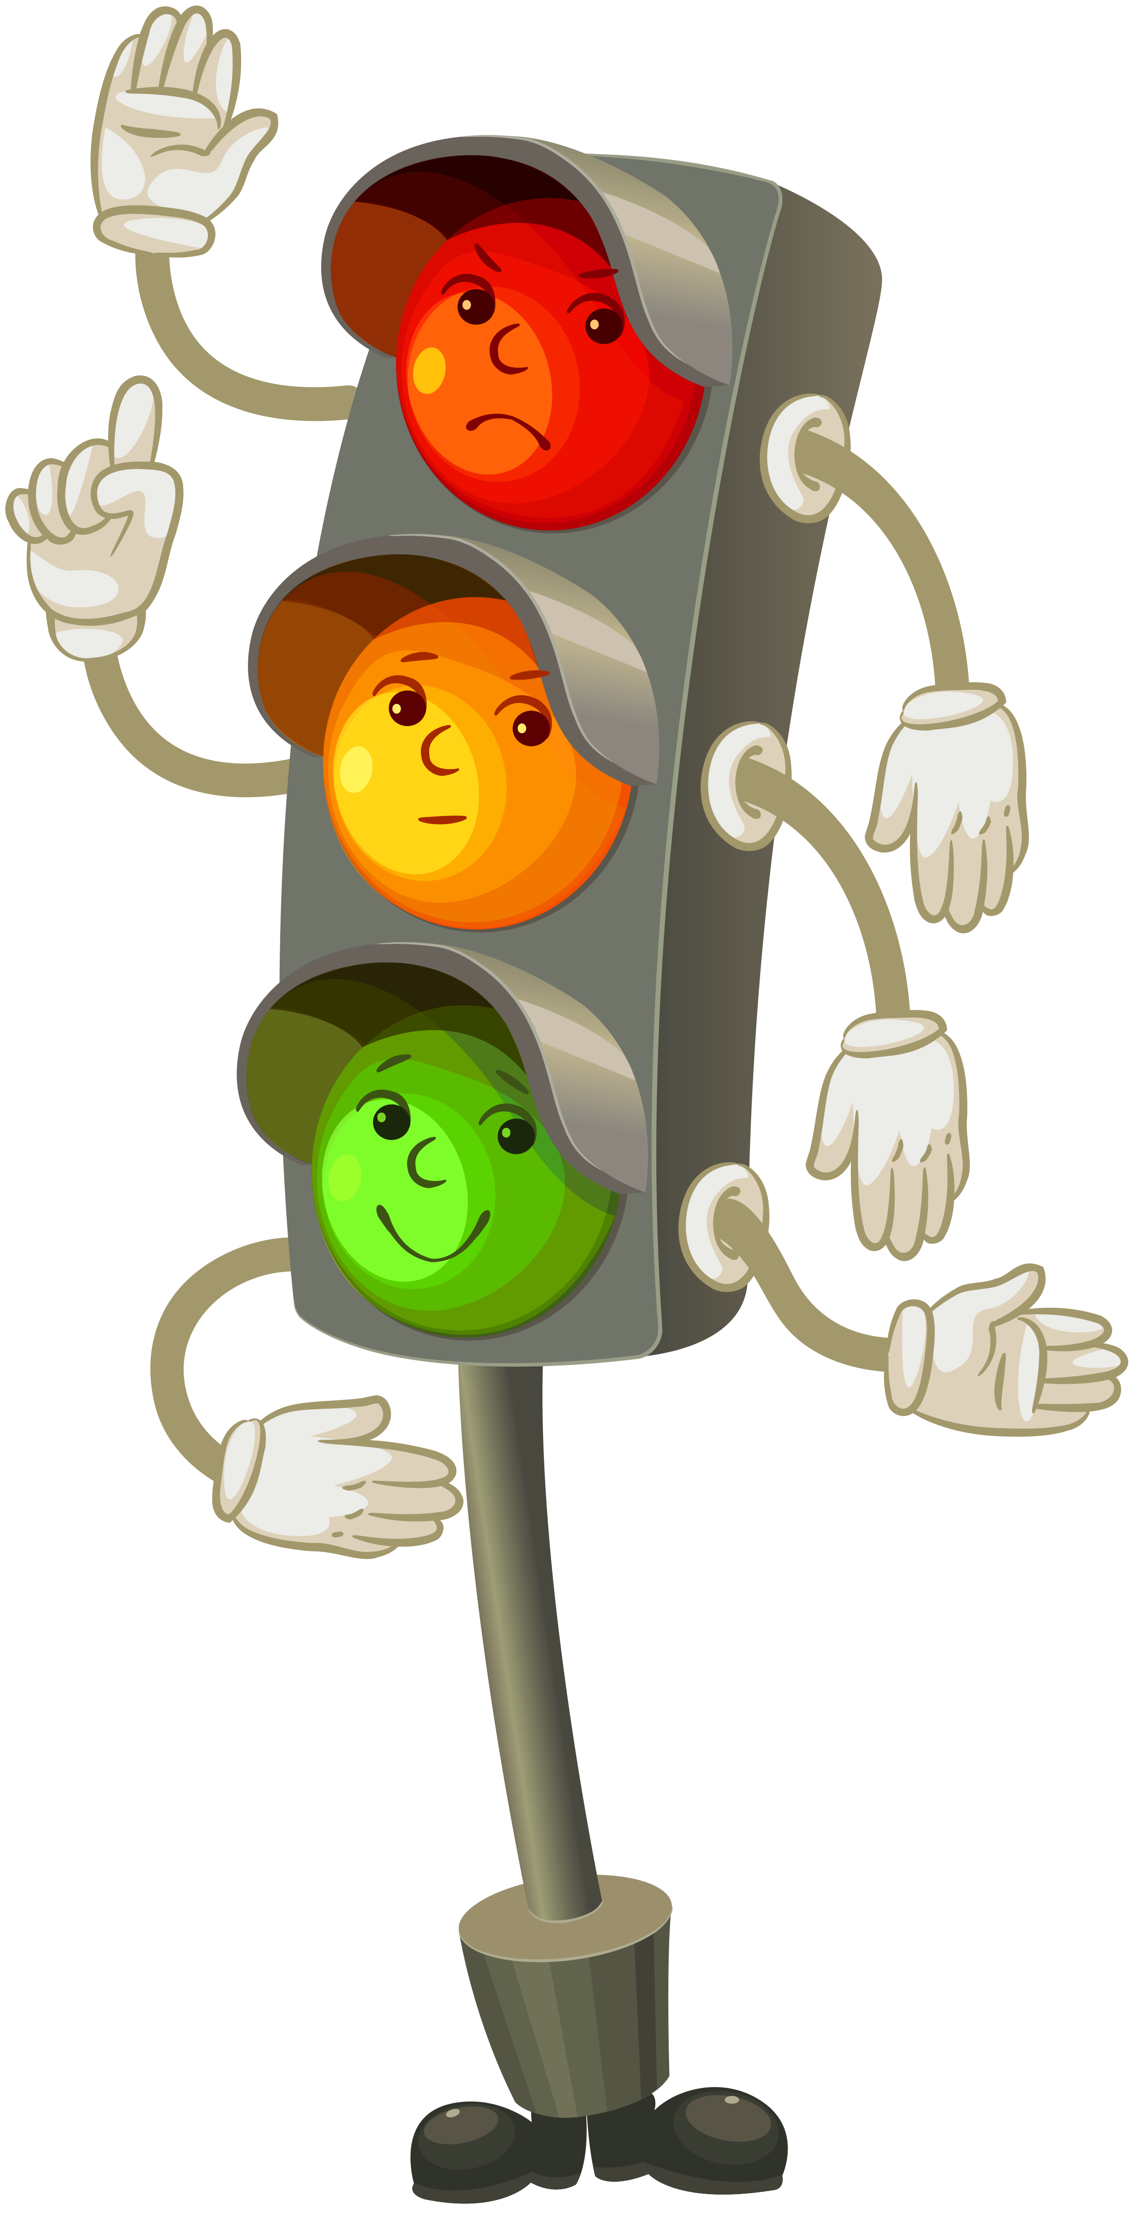
You must stop if you are red.
You can stay temporarily if you are in yellow.
You can go if you are in green because you have learnt to use stress.
If you are in blue you may need assistance, help, advice from others.

Slide 26

Check where you are?
Passive Avoidance
Low risk taking
Lack of motivation
Blaming
Dependent
Procrastinate
Lack of skills
Active
Optimistic
Self control
Personal responsibility
Goal directed
Mastery oriented
Motivated
Thoughtful

Slide 27

Check where you are?
Confused Distracted
Disappointed
Pessimistic
Impulsive
No clear plan or goal
Under mild stress
Under stress
Non-Acceptance
Unfinished business
Dissatisfied
Give up
Withdrawal
Helpless, hopeless
Illness
Disaster

Slide 28
Do Something
Cry or Laugh
Listen to music
Draw or paint
Keep pets
Go for a walk

Slide 29
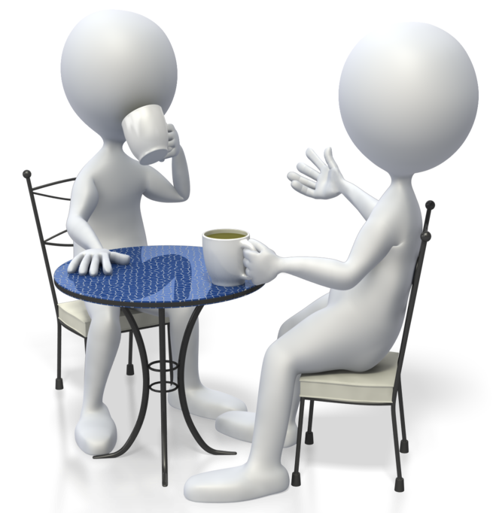
Talking to Someone
Sometimes bottling your thoughts inside you can make the reactions worse
It may be helpful to talk to a friend or family member about the event and what you are feeling
It may also be helpful for you to share your feelings with someone who was involved in the event.

Slide 30

Coping Option
3 C
Change environment
(flight)
Change the environment
(flight)
Change yourself
attitude, belief

Slide 31
Coping Option
Unacceptable – try to accept
Uncertain - reduce it
Uncontrollable – we have choice
There is only one problem that is the fear of unable to cop

Slide 32
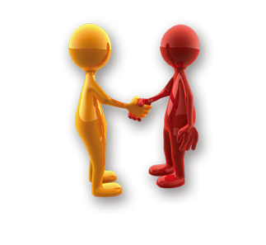
You are not ALONE
we are here to help you.

